Slide 1
Artificial Neural Networks
CSE301 Bio-computation, Week 4, 2016
Bailing Zhang

Slide 2
Multilayer Perceptrons
The multilayer perceptron (MLP) is a hierarchical structure of several perceptrons, which overcomes the shortcomings of the single-layer networks.
The MLP neural network is able to learn nonlinear function mappings.
  learning a rich variety of nonlinear decision surfaces.
Nonlinear functions can be represented by MLPs with units that use nonlinear activation functions.
  Multiple layers of cascaded linear units still produce only linear mappings!

Slide 3
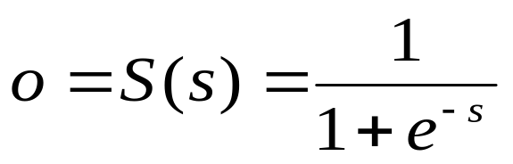
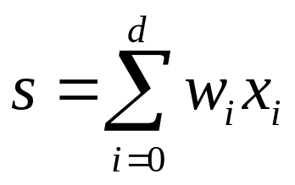
Differentiable Activation Functions
Training algorithms for MLP require differentiable, continuous nonlinear activation functions.
Such a function is the sigmoid, or logistic function:
where s is the sum:
which is the products from the weights w_{i} and the inputs x_{i} .
_{You can use}
_{fplot('1/(1+exp(-x))',[-1 1])}
_{to plot it}

Slide 4
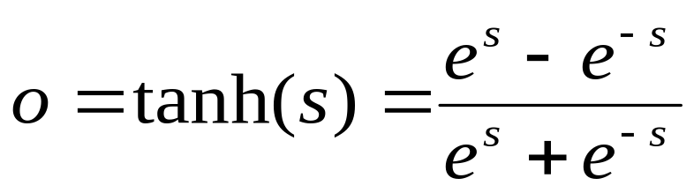
Differentiable Activation Functions
Another nonlinear function often used in practice is the hyperbolic tangent:
Sometimes the hyperbolic tangent is preferred as it makes the training a little easier.

Slide 5
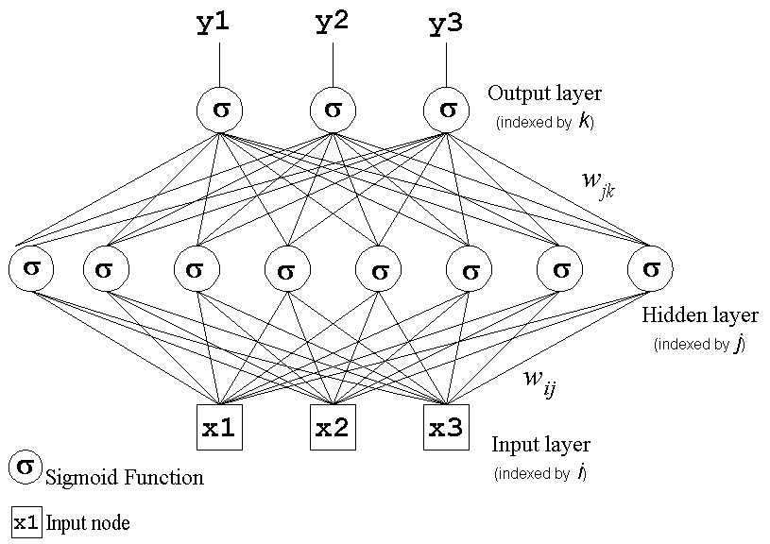
Multilayer Network Structure

Slide 6
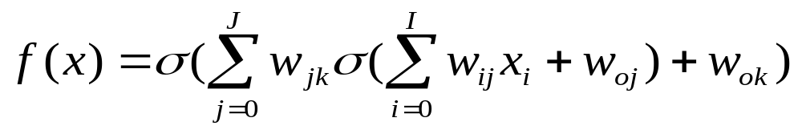
Multilayer Network Structure
A two-layer neural network implements the function:
where: x is the input vector,
w_{0j} and w_{0k} are the bias terms,
w_{ij} are the weights connecting the input with the hidden nodes
w_{jk} are the weights connecting the hidden with output nodes
σ is the sigmoid activation function.
Output from hidden layer

Slide 7
Multilayer Network Structure
The hidden units enable the multilayer network to learn complex tasks by extracting progressively more meaningful information from the input examples.
The MLP has a highly connected topology since every input is connected to all nodes in the first hidden layer, every unit in the hidden layers is connected to all nodes in the next layer, and so on.
The input signals, initially these are the input examples, propagate through the neural network in a forward direction on a layer-by-layer basis, that is why they are often called feedforward multilayer networks.

Slide 8
Representation Power of MLP
Properties concerning the representational power of MLP:
  learning arbitrary functions: any function can be learned with an arbitrary accuracy by a three-layer network;
  learning continuous functions: every bounded continuous function can be learned with a small error by a two-layer network (the number of hidden units depends on the function to be approximated);
  learning boolean functions: every boolean function can be learned exactly by a two-layer network although the number of hidden units grows exponentially with the input dimension.

Slide 9
Backpropagation Learning Algorithm
MLP became applicable on practical tasks after the discovery of a supervised training algorithm, the error backpropagation learning algorithm.
  The backpropagation algorithm for training multilayer neural networks is a generalization of the LMS training procedure for nonlinear logistic outputs.
  As with the LMS procedure, training is iterative with the weights adjusted after the presentation of each example.
The error backpropagation algorithm includes two passes through the network:
- forward pass, and
- backward pass.

Slide 10
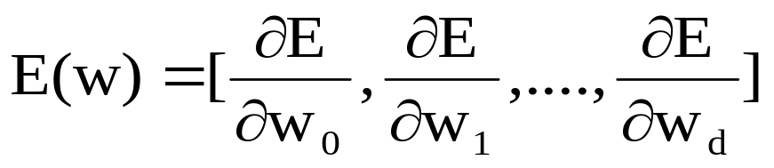
Backpropagation Learning Algorithm
During the backward pass the weights are adjusted in accordance with the error correction rule. It suggests that the actual network output is subtracted from the given output in the example. The weights are adjusted so as to make the network output more closer to the desired one.
The backpropagation algorithm does gradient descent as it moves in direction opposite to the gradient of the error, that is in direction of the steepest decrease of the error.
This is the direction of most rapid error decrease by varying all the weights simultaneously in proportion of how much good is done by the individual changes:
▽

Slide 11
Backpropagation Learning Algorithm
▽
By gradient descent search, backpropagation training algorithm minimizes a cost function E (the mean square difference between the desired and actual net outputs).
The network is trained initially selecting small random weights and then presenting all training data incrementally.
Weights are adjusted after every trial using side information specifying the correct class until weights converge and the cost function is reduced to an acceptable value.

Slide 12
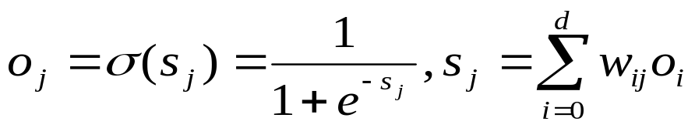
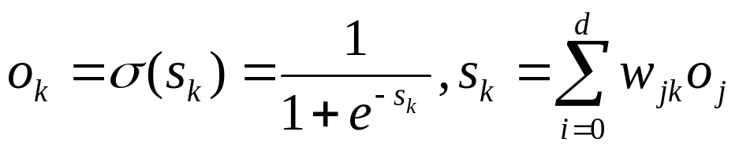
Backpropagation Training Algorithm
Initialization: Examples {( x_{e}, y_{e} )}_{e=1}^{N}, initial weights w_{i} set to small random values, learning rate η = 0.1
Repeat
  for each training example ( x, y )
  - calculate the outputs using the sigmoid function:
  where o_{i} = x_{i}
_{at the hidden units j}
_{at the output units k}

Slide 13

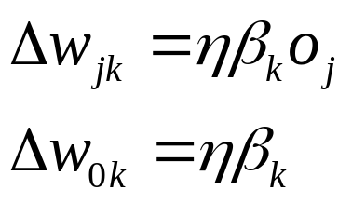
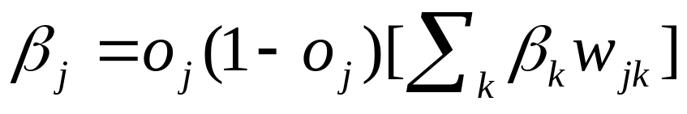
Backpropagation Training Algorithm
compute the benefit β_{k} at the nodes k in the output layer:
compute the changes for weights j→ k on connections to nodes in the output layer:
compute the benefit β_{j} for the hidden nodes j with the formula:
_{effects from the output nodes}
effects from the output of the neuron
effects from multiple nodes in the next layer

Slide 14
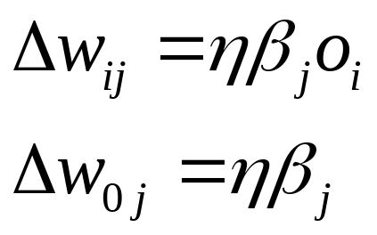
Backpropagation Training Algorithm
  compute the changes for the weights i →j on connections to nodes in the hidden layer:
update the weights by the computed changes:
w = w + Δw
until termination condition is satisfied.

Slide 15
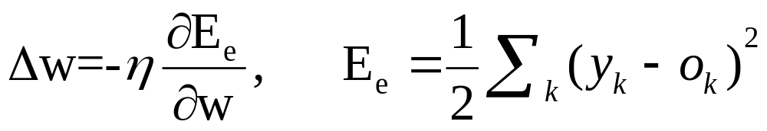
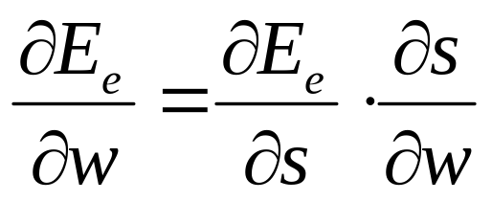
Derivation of Backpropagation Algorithm
The BP training algorithm for MLP is a generalized delta rule, according to which with each training example every weight is updated as follows:
w = w + Δw
where:
The implementation of the generalized delta rule requires to derive an expression for the computation of the derivatives ∂E_{e}/∂w

Slide 16
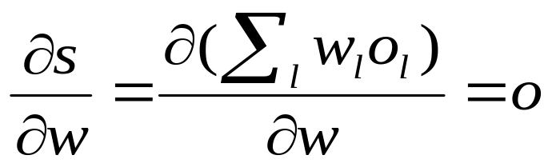
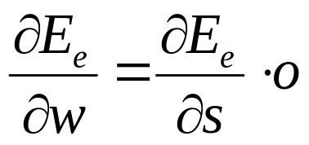
Derivation of Backpropagation Algorithm
The first part ∂E_{e}/∂s reflects the change of the error as a function of the change in the network weighted input to the unit.
The second part ∂s/∂w reflects the change of the error as a function of the change of particular weight w to that node. Since:
the expression is reduced as follows:

Slide 17
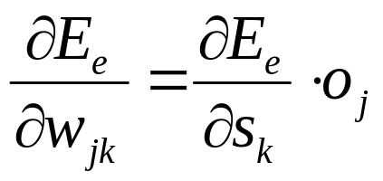
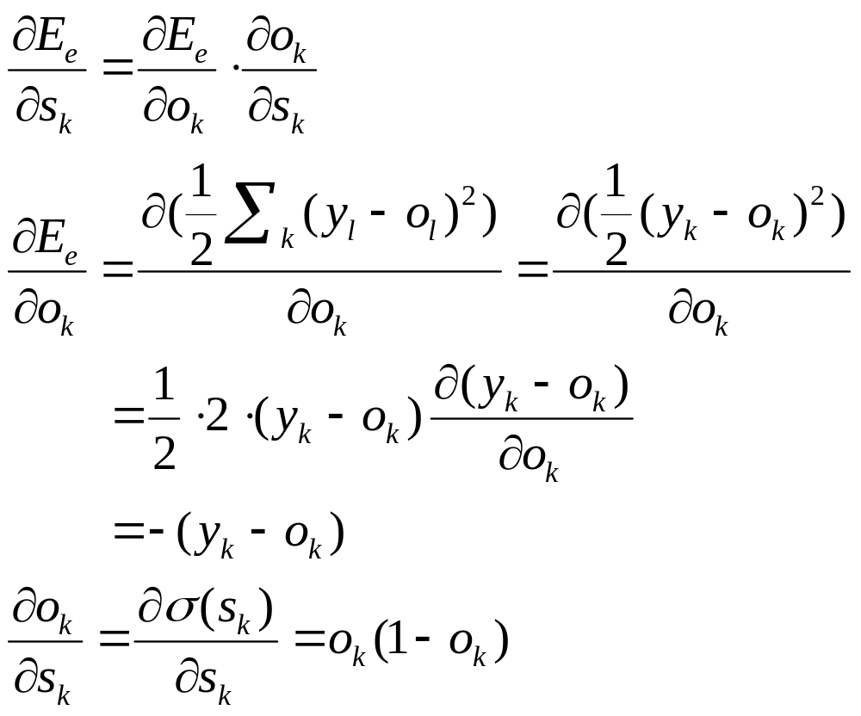
Derivation of Backpropagation Algorithm
Delta Rule for weights j →k on connections to nodes in the output layer:

Slide 18
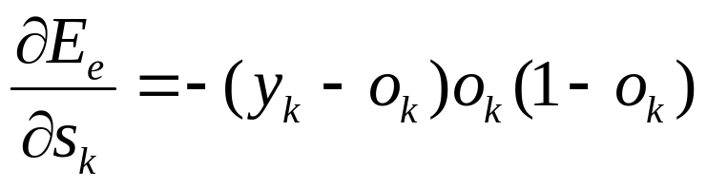
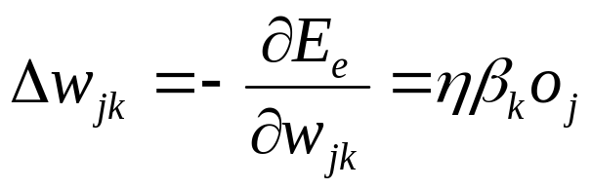
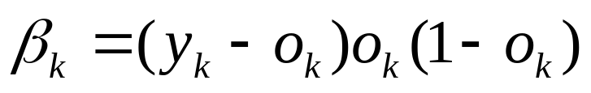
Derivation of the Backpropagation Algorithm
Therefore:
and when we substitute:
the Delta rule for the output units becomes:

Slide 19
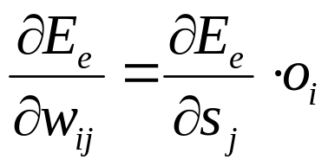
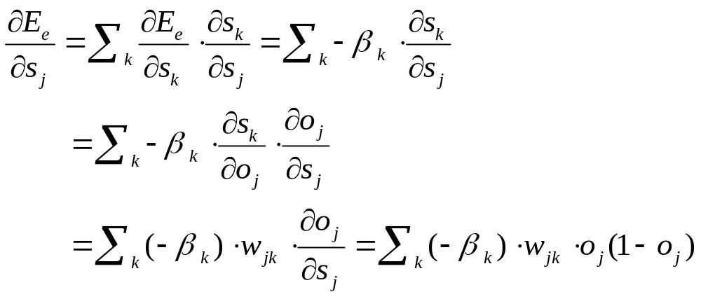
Derivation of the Backpropagation Algorithm
Delta Rule for weights i→j on connections to nodes in the hidden layer
In this case the error depends on the errors committed by all output units:

Slide 20
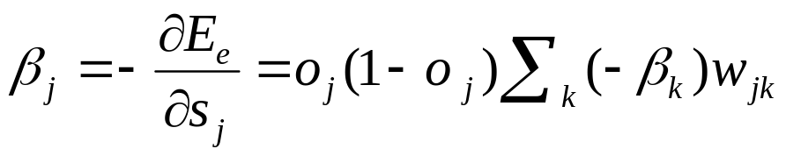
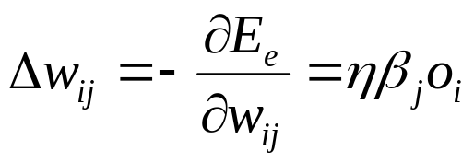
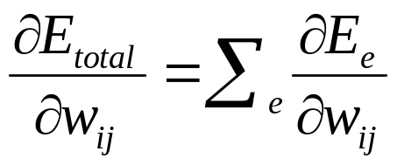
Derivation of the Backpropagation Algorithm
Therefore, when we substitute:
the Delta rule for the hidden units becomes:
Note: This analysis was made for a single training pattern, but it can be generalized so that:
Thus, we just need to sum out weight changes over the examples.

